Slide 1


Pilot Study Update
Client: Exyte
Location: Singapore
Date : 06 Mar 2024

Slide 2
Note
Run 1 (Short term test) is completed on 2 Feb 2024.
Run 2 (Continuous test) is completed on 23 Feb 2024, sample analysis is ongoing.

Slide 3
Water analysis – Run 1
Sample | LSR A2 | HFW A1+A2 | HFW Gas Room | HFW Chem Room
pH | 3.93 | 3.48 | 3.15 | 2.71
Fluoride (mg/L) | 64 | 402 | 202 | 4358
Chloride (mg/L) | 11.1 | 481.7 | 10.7 | 18.5
Phosphate (mg/L) | <0.1 | 7.87 | 4.8 | 421.4
Sulfate (mg/L) | 4.0 | 6.3 | 2.4 | 5.9
Nitrate (mg/L) | 2.0 | 243.6 | 443.5 | 401.5
Ammonium as NH4 | 21.9 | 10.5 | 1.41 | 5.01
Calcium | 0.98 | 0.88 | 0.23 | 0.46
Magnesium | <0.1 | 0.315 | <0.1 | <0.1
Potassium | <0.1 | 0.238 | <0.1 | <0.1
Total Silica | 19.4 | 14.7 | 6.74 | <0.1
Sodium | 11.6 | 176 | 105 | 40.6
TOC | 7.35 | 25.7 | 9.64 | 31.7
Conductivity (uS/cm) | 354 | 1738 | 2010 | 7500
3

Slide 4
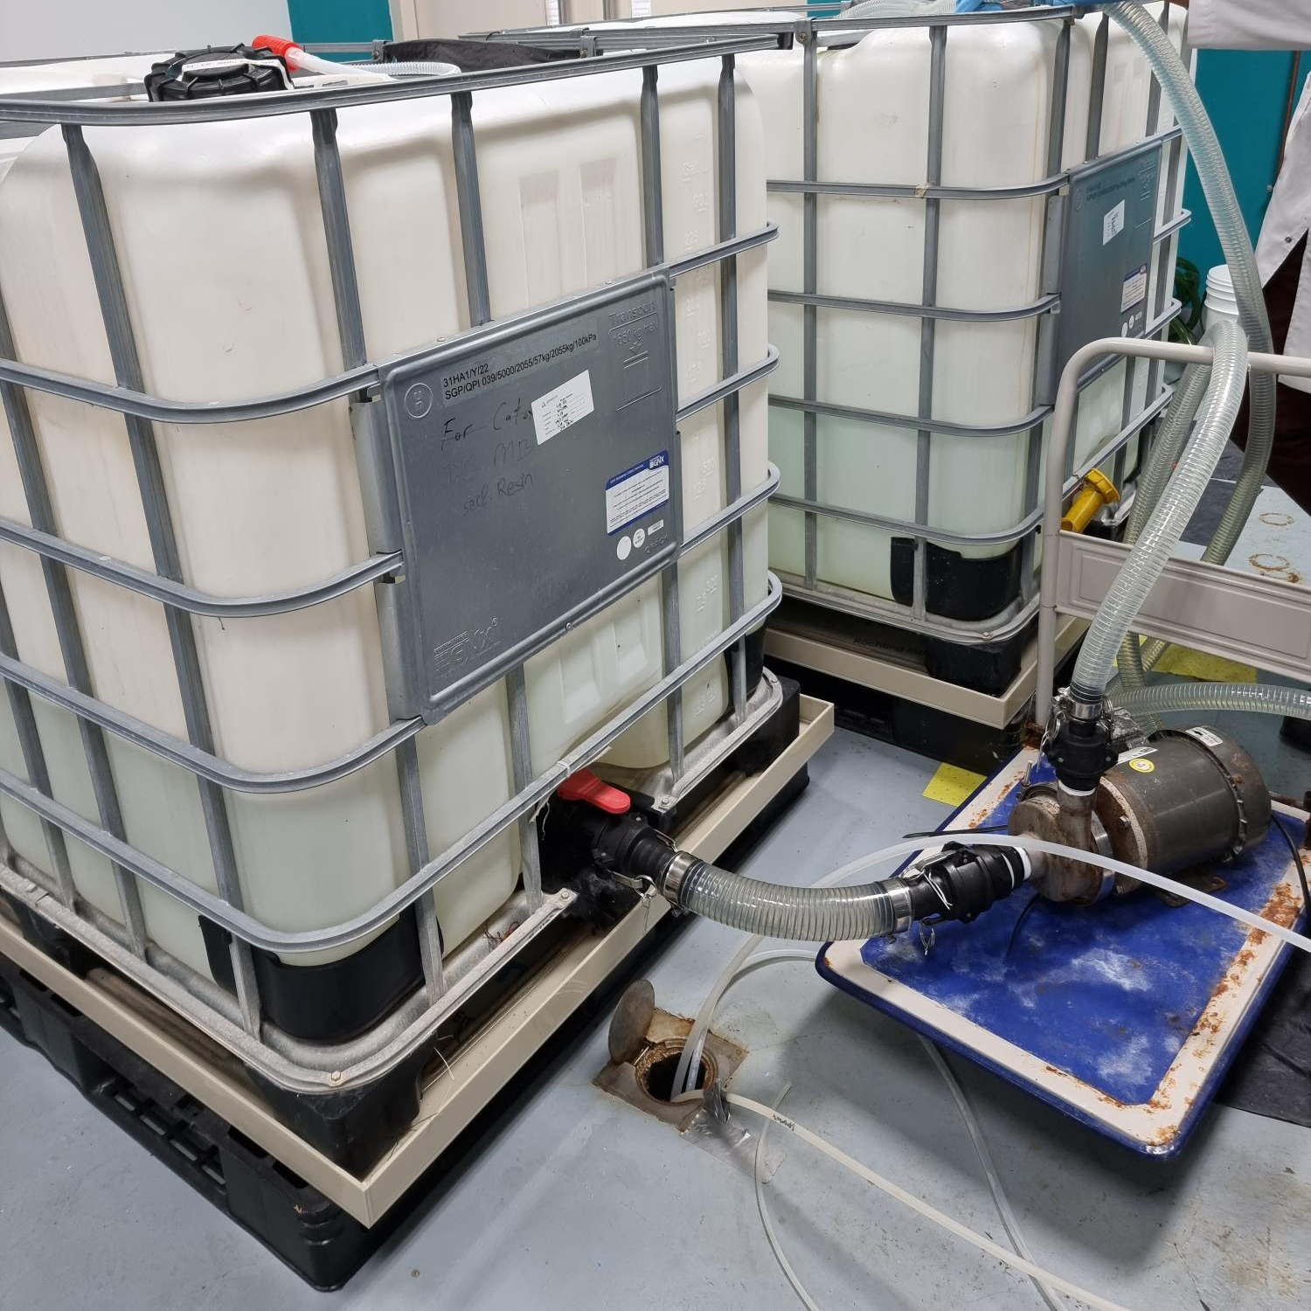
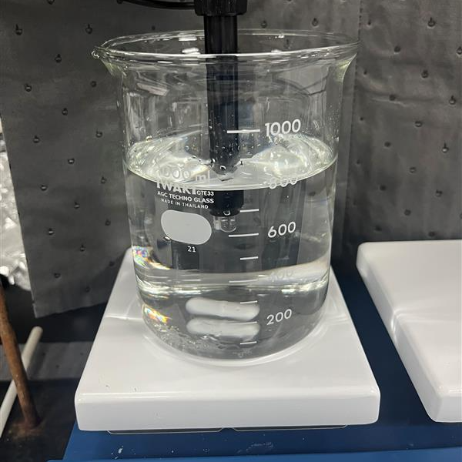
Run 1 (Short term test) Experimental Procedure
Mixing ratio LSR A2: HFW A1+A2: Chem Room = 1:1:0.03 (600 L: 600L: 16L) found out from bench test
Fluoride = 307 mg/L in the mixture
To achieve the required amount of feed fluoride (F = 350 mg/L), 114 g NaF was added to make the feed solution for Run 1
2 ppm Vitec 4000 was added into the feed tank
SBRO experiment started with 15 mins service duration + 110 sec flushing duration
4

Slide 5
Experimental conditions
Feed water volume = 1216 L
Feed water fluoride = 366 mg/L
Feed flowrate = 7.7 LPM (0.46 m3/hr)
Permeate flowrate = 6 LPM (0.36 m3/hr)
SBRO service duration = 15 mins, flushing duration 110 sec
Recovery = 78%

Slide 6
Run 1 Water analysis
Sample | Feed | Reject | Permeate
pH | 7.34 | 7.26 | 6.46
Conductivity (µS/cm) | 2310 | 7380 | 82.4
Bicarbonate alkalinity | 28.0 | 129.6 | 0.8
Fluoride (mg/L) | 366 | 1307 | 8
Chloride (mg/L) | 34.2 | 64 | 2.87
Phosphate (mg/L) | 10.7 | 38 | <1
Sulfate (mg/L) | 6.8 | 21.3 | 1.4
Nitrate (mg/L) | 153 | 507 | 15.9
Ammonium as NH4 (mg/L) | 17.5 | 0.5 | 3.3
Aluminium (mg/L) | 0.13 | 0.22 | <0.1
Boron (mg/L) | 2.85 | 10.23 | 0.53
Calcium (mg/L) | 0.47 | 1.43 | <0.1
Magnesium (mg/L) | <0.1 | 0.175 | <0.1
Iron as Fe (mg/L) | 0.126 | 0.383 | <0.1
Potassium (mg/L) | 5.178 | 6.369 | 0.422
Total Silica (mg/L) | 13.3 | 52.0 | <0.2
Sodium (mg/L) | 503 | 1631 | 11.5
TOC (mg/L) | 18.5 | 57.0 | 3.1
TDS (mg/L) | 1136 | 3976 | 44

Slide 7
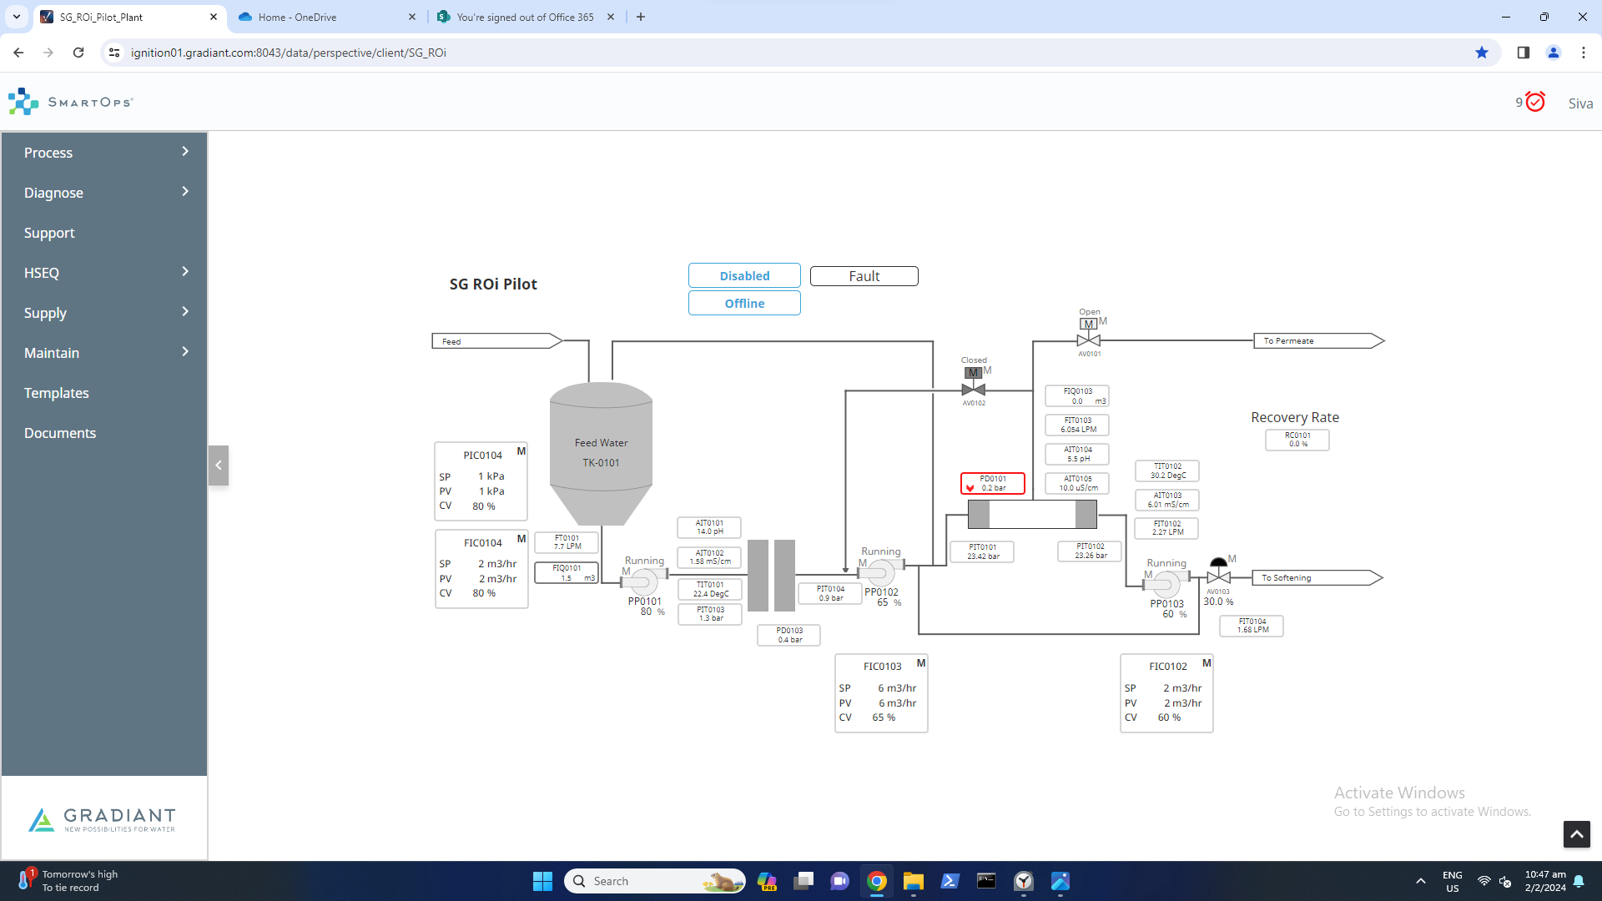

Slide 8
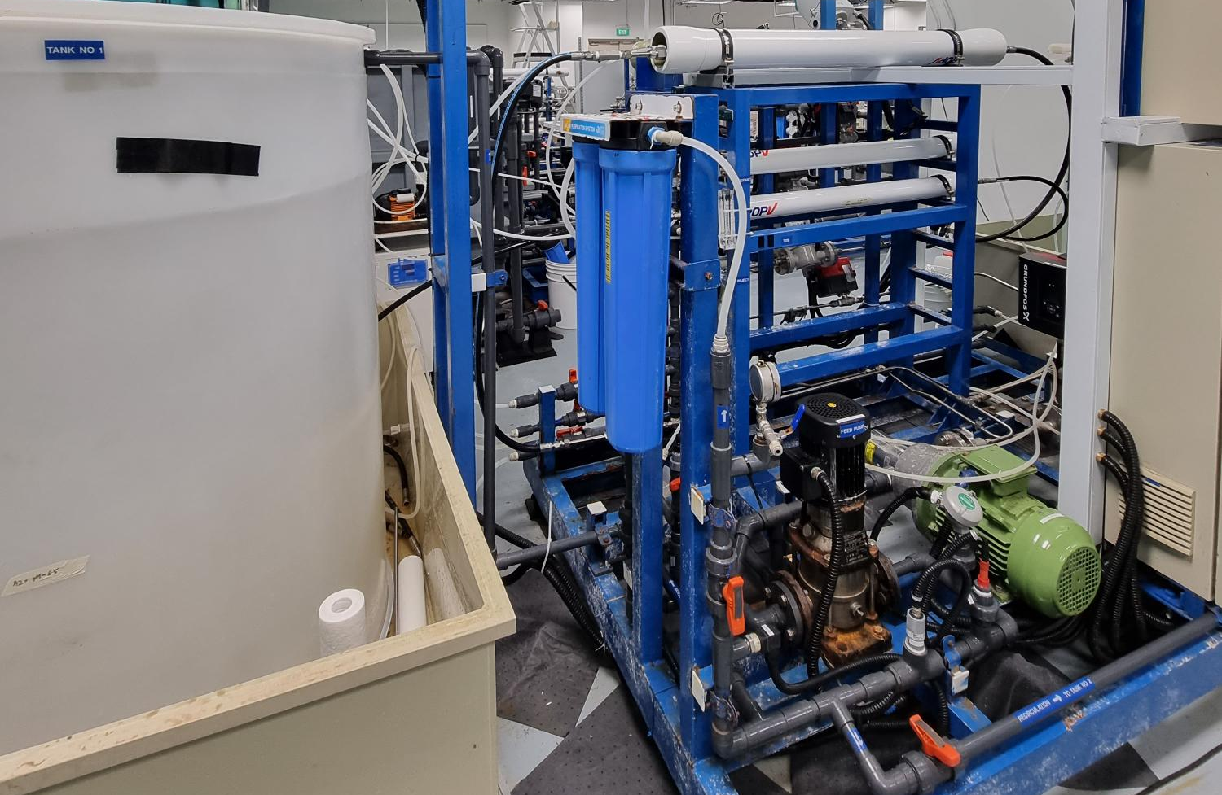
BW30 PRO-4040
Cartridge filter
Feed tank
Booster pump
High pressure pump
Notes:
Taking video for the setup, membrane autopsy after the end of the run?

Slide 9
Run 1 - SBRO Reject Conductivity and feed pressure profile

Slide 10
Run 1 – Feed pressure and permeate flowrate profile

Slide 11
Summary – Run 1
Initial F = 366 mg/L (>350 mg/L)
Recovery = 78% (>75%)
Effluent F = 8 mg/L (<10 mg/L)

Slide 12
Experimental conditions – Run 2
Feed water volume = 1350 L
Feed water fluoride = 353.5 - 409 mg/L
Feed flowrate = 7.7 – 7.9 LPM (0.46 – 0.47 m3/hr)
Permeate flowrate = 6.0 - 6.1 LPM (0.36 m3/hr)
SBRO service duration = 15 mins, flushing duration 110 sec
Recovery = 75.5 – 78.6%

Slide 13
Run 2 Feed water analysis
Sample | Feed 1 | Feed 2 | Feed 3 | Feed 4
pH | 6.45 | 6.85 | 7.02 | 7.06
Conductivity (µS/cm) | 2280 | 2130 | 2203 | 2200
Bicarbonate alkalinity
Fluoride (mg/L) | 409 | 353.5 | 381 | 403
Chloride (mg/L) | 23.4 | 31.4 | 26.9 | 22.3
Phosphate (mg/L) | 7.92 | 4.87 | 3.6 | 3.01
Sulfate (mg/L) | 4.89 | 6.15 | 5.72 | 5.88
Nitrate (mg/L) | 167 | 100.5 | 91.2 | 109
Ammonium as NH4 (mg/L) | 19.4 |  | <0.4 | 0.4
Aluminium (mg/L) | <0.1 | <0.1 | <0.1 | 0.158
Boron (mg/L) | 2.88 | 3.53 | 1.18 | 1.87
Calcium (mg/L) | 0.31 | <0.1 | 0.127 | 0.117
Magnesium (mg/L) | <0.1 | <0.1 | <0.1 | <0.1
Iron as Fe (mg/L) | 0.141 | 0.4 | 0.13 | 0.146
Potassium (mg/L) | <0.1 | 0.885 | 1.145 | 0.907
Total Silica (mg/L) | 20.4 | 21.3 | 22.9 | 28.1
Sodium (mg/L) | 529.3 | 475 | 479.1 | 527.8
TOC (mg/L) | 6.43 | 15.1 | 14.5 | 15.1
TDS (mg/L) | 1145 | 1047 | 1106 | 1114

Slide 14
Run 2 Permeate analysis
Sample | Specs | Permeate 1 | Permeate 2 | Permeate 3 | Permeate 4
pH | 7-9 | 5.6 | 6.65 | 7.42 | 7.35
Conductivity (µS/cm) | 5-300 | 82 | 53.2 | 62.9 | 65.2
Fluoride (mg/L) | 15 | 9.27 | 6.3 | 7.42 | 6.71
Chloride (mg/L) | 50 | 1.36 | 1.32 | 1.44 | 2.51
Sulfate (mg/L) | 50 | <0.1 | 0.145 | 0.146 | <0.1
Aluminium (mg/L) | 0.2 | <0.1 | <0.1 | <0.1 | <0.1
Boron (mg/L) | 1 | 0.382 | 0.271 | 0.298
Calcium (mg/L) | 3 | <0.1 | <0.1 | <0.1
Magnesium (mg/L) | 3 | <0.1 | <0.1 | <0.1
Iron as Fe (mg/L) | 0.3 | <0.1 | <0.1 | <0.1
Potassium (mg/L) | 5 | 0.175 | 0.243 | 0.271
Silica as Si (mg/L) | 30 | <0.1 | <0.1 | 0.111 | <0.1
Sodium (mg/L) | 50 | 11 | 8.11 | 8.67
TOC (mg/L) | 3
TSS (mg/L) | <100
Free chlorine (mg/L) | 0.3 | 0.03 | 0.05 | 0.02 | 0.02

Slide 15
Run 2 Reject analysis
Sample | Reject 1 | Reject 2 | Reject 3 | Reject 4
pH | 6.81 | 7.35 | 7.01 | 7.12
Conductivity (µS/cm) | 7450 | 7450 | 7493 | 7255
Bicarbonate alkalinity
Fluoride (mg/L) | 1247 | 1379 | 1302 | 1330
Chloride (mg/L) | 101.3 |  | 82.6
Phosphate (mg/L) | 32.4 | 18.2 | 12 | 11.8
Sulfate (mg/L) | 15.97 | 12.5 | 19.5 | 18.4
Nitrate (mg/L) | 519.6 | 348 | 289.1 | 387
Ammonium as NH4 (mg/L)
Aluminium (mg/L) | 0.149 | 0.131 | <0.1 | 0.106
Boron (mg/L) | 17.6 | 13.8 | 11.7 | 9
Calcium (mg/L) | <0.1 | <0.1 | <0.1 | 0.477
Magnesium (mg/L) | <0.1 | <0.1 | <0.1 | <0.1
Iron as Fe (mg/L) | 0.566 | 0.445 | 0.502 | 0.488
Potassium (mg/L) | 5.09 | 5.18 | 5.56 | 5.48
Total Silica (mg/L) | 74.0 | 104 | 107 | 105
Sodium (mg/L) | 1811 | 1874 | 1723 | 1642.5
TOC (mg/L)
TDS (mg/L) | 4105 | 3923 | 4002 | 3864

Slide 16
Run 2 – Feed pressure profile

Slide 17
Summary – Run 2
Date | Long term | Recovery (%) | Feed pH | Feed nitrate (mg/L) | Feed fluoride (mg/L) | Permeate fluoride (mg/L) | Fluoride rejection (%)
20 Feb 24 | Run 1 | 78.6 | 6.45 | 167 | 409 | 9.27 | 97.7
21 Feb 24 | Run 2 | 77.0 | 6.85 | 100.5 | 353.5 | 6.30 | 98.2
22 Feb 24 | Run 3 | 77.1 | 7.02 | 91.2 | 381 | 7.42 | 98.1
23 Feb 24 | Run 4 | 75.5 | 7.06 | 109 | 403 | 6.71 | 98.3

Slide 18
HFW and LSR sampling points – Run 3
Sampling points | Volume (L) | Total volume for each collection (L) | Frequency in 2 days | Total quantity per tote (L)
HFW
HFW Gravity Drain A1 | 175 x 2 | 250 x 2 | 4 x 2 | 1000 x 2* (1m³)
HFW Gravity Drain A2 | 75 x 2
HFW Gravity Drain Chem Room | 5 x 2 | 5 x 2 |  | 20 x 2*
LSR A2
LSR A2 transfer pump | 250 x 2 | 250 x 2 | 4 x 2 | 1000 x 2 (1m³)
Ratio HFW A1: A2= 7:3
*Note: (1) 2 IBCs of HFW A1+A2 and LSR A2 (2) 2 carboys of HFW Chem Room will be collected
The mixing will be done in GIH lab
Sample to be collected 2 times a day in 2 days

Slide 19
Schedule
Event | Description | Date
01 | Pilot Readiness | 25-Jan
02 | Sample Collection at Site | 18-Jan to 25-Jan 23 Jan – 2 Feb
03 | Micron/Exyte witness | 01-Feb – Exyte visit
04 | Pilot Operation | 02-Feb to 23-Feb
05 | Report Preparation | 23-Feb to 07 Mar
06 | Draft Submission Review | 23-Feb to 07-Mar
07 | Final Report Submission | 08-Mar to 15-Mar

Slide 20


